Slide 1
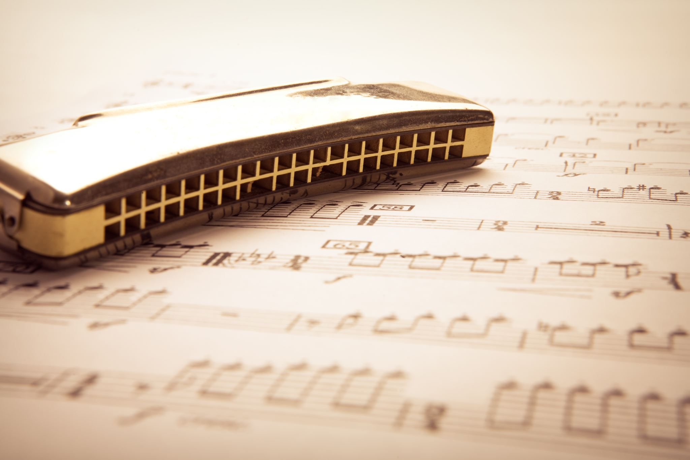
MUSIC GENRE CLASSIFIER
By Yuval Hoffman and Roee Hadar

Slide 2
Introduction
Music classification is used by many in order to improve our music experience.
The music classification is a multi-lables ML problems.
Our DataBase is ‘gtzan’ consists of 30s of 1000 songs, and have a 10 categories.
Our model’s paper is “DistilHuBERT: Speech Representation Learning by Layer-wise Distillation of Hidden-unit BERT”.
We used his trained model and using augmentation. The augmentation didn’t improve the accuracy.

Slide 3
The PROBLEM
Music classification vs Image classification.
Music genre can be identified with only small part of the song.
A song might have multiple genre.
Image processing is focused on object recognition.
We used his trained model and using augmentation we improved its results by ##.

Slide 4
The Pre-tuned MODEL
The DistilHuBERT model is a distillation model of HuBERT, a self-supervised model based.
The distillation based on teacher – student framework.
The model consists of:
CNN Encoder
A few musk area.
Attention
Dropout
## parameters
The HuBERT model is a Pre-tuned on LLM DB “Librispeech”.
Transform Learning to Music Genre Classifier.

Slide 5
The gtzan DataBase:
There are 10 genres, each containing 100 tracks which are all 22050Hz Mono 16-bit audio files in .wav format.
We trained on 40% (~40 song per category) and validate on 10% (~10 song per category).
The genres are:
blues
classical
country
disco
hiphop
jazz
metal
pop
reggae
rock

Slide 6
Augmentation of song
White Noise:
Add 5% White Noise to the audio.
Pitch Shifting:
Increase (or decrease) the main frequency of the audio by about -5%~5%.
BSF:
BSF 20% of the audio bandwidth at random central frequencies.

Slide 7
Results
DATABASE: | GTZN | GTZN+Noise | GTZN+Pitch Shift | GTZN+BSF
Accuracy | 78% | 73% | 75% | 78%

Slide 8
Results
DATABASE: | GTZN | GTZN+Noise | GTZN+Pitch Shift | GTZN+BSF
Accuracy | 78% | 73% | 75% | 78%

